Slide 1
SQL

Slide 2
We have a small store and want to implement a data model to administer orders. We need the following tables:
An ORDER table with the following columns:
ORDER_NO(order number),
ORDER_DATE(date when the order was placed),
CUST_NO(customer number),
ORDER_REF(reference to another order).
An ORDER_ITEM table with columns:
ORDER_NO(order number of the associated order),
ART_NO(article number),
ORDER_QTY(quantity ordered).
An ARTICLE table with the following columns:
ART_NO(article number),
ART_NAME(name for the article),
STOCK_QTY(number of items in stock ).

Slide 3
create table order (
order_no integer not null,
order_date date not null,
cust_no integer not null
);
alter table order
add order_ref integer; - The new column must be defined as nullable or with NOT NULL WITH DEFAULT.
create table article (
art_no integer not null,
art_name char(20) not null,
stock_qty integer not null)
);

Slide 4
create table order_item (
order_no integer not null,
order_qty integer not null,
art_no integer not null,
CONSTRAINT ORDER_LIMIT
CHECK(order_qty <= 100),
CONSTRAINT SPECIAL_ORDER
CHECK(art_no <= 50000 OR order_qty <= 10)
);
alter table order_item
drop CONSTRAINT ORDER_LIMIT;
alter table order_item
add CONSTRAINT ORDER_LIMIT
CHECK(art_no < 50000 OR order_qty <= 10);

Slide 5
create table new_order
like order; - creates a new table with the same column definitions (column name, data type and null attribute) as the existing table.
create table new_order
as (select col1, col2, col3 from order)
definition only/with data/with no data; - uses a query to define a new table.
CREATE TABLE ....LIKE creates a new table with the same column definitions (column name, data type and null attribute) as the existing table.
- No unique constraints, foreign key constraints, triggers, or indexes are created.
- The table is not populated.
CREATE TABLE --- DEFINITION ONLY uses a query to define a new table.
- The table is not populated using the result of query.

Slide 6
Check constraints can be defined on a new table with the CREATE TABLE statement.
Check constraints can be added to an existing table with the ALTER TABLE statement.
Constraints may include the basic WHERE clause constructs:
Basic comparisons (>, <, =, >=, etc.)
BETWEEN
LIKE
IN
Constraints may NOT include:
Subqueries
Column functions
Special registers (such as CURRENT DATE)

Slide 7
Update
UPDATE table_name
SET column1 = value1, column2 = value2, ...
WHERE condition;
Delete - The DELETE statement is used to delete existing records in a table.
DELETE FROM table_name WHERE condition;
Drop - The DROP TABLE statement is used to drop an existing table in a database.
DROP TABLE table_name;

Slide 8
Indexes
- are the database objects created based on one or more columns of a table. Indexes are used to improve the query performance and guarantee uniqueness when defined as unique indexes.
CREATE INDEX – show you how to create a new index.
DROP INDEX – describe how to delete an index from the database.
UNIQUE INDEX – ensure the uniqueness of values stored in one or more columns.
CREATE (UNIQUE) INDEX index_name
ON table_name(column1, column2, ...);

Slide 9
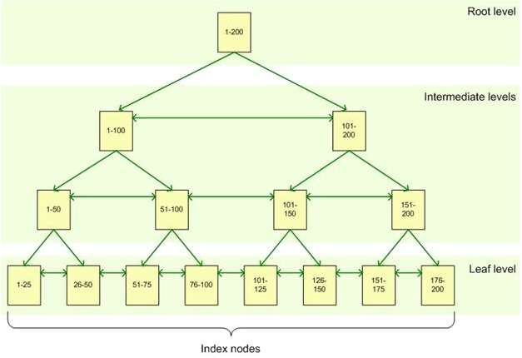

Slide 10
Create index
CREATE INDEX ORDER_INFO
ON order(order_no, art_no)
CREATE UNIQUE INDEX UNIQUE_NUMBER
ON article(art_no)
drop index ORDER_INFO
drop index UNIQUE_NUMBER

Slide 11
When creating a new row in the ORDER_ITEM table, the order number should already exist in the ORDER table and the article number should already exist in the ARTICLE table.
If I delete an order in the ORDER table, all rows in the ORDER_ITEM table that refer to that order should be deleted automatically.
It should not be possible to delete a row in the ARTICLE table if the ORDER_ITEM table has rows which refer to this article.
When creating a new row in the ORDER table, the ORDER_REF column may refer to another order of the ORDER table. This order must already exist.

Slide 12
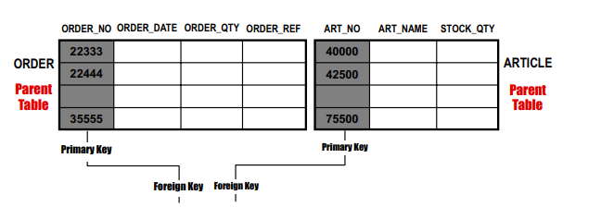
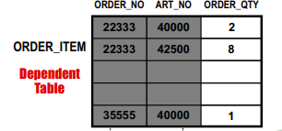
ALTER TABLE ORDER
ADD PRIMARY KEY (ORDER_NO);
ALTER TABLE ARTICLE
ADD PRIMARY KEY (ART_NO);
ALTER TABLE ORDER_ITEM
ADD PRIMARY KEY (OEDER_NO, ART_NO);
The values in Primary Key column must be unique and not null.
DB2 ensures that a PRIMARY KEY/UNIQUE KEY is updated only if no FOREIGN KEY matches the original value of the primary/unique key.
The ORDER_ITEM table has a primary key on the combination of the ORDER_NO and ART_NO columns.

Slide 13
Delete Rules
DELETE NO ACTION
Specifies that the row in the parent table can be deleted if no other row depends on it. If a dependent row exists in the relationship, the DELETE fails. The check for dependent rows is performed at the end of the statement.
DELETE RESTRICT
Specifies that the row in the parent table can be deleted if no other row depends on it. If a dependent row exists in the relationship, the DELETE fails. The check for dependent rows is performed immediately.
DELETE CASCADE
Delete the row with the matching value in the dependent table.
DELETE SET NULL
Change the matching value in the dependent table to null.

Slide 14
Alter table - Adding Referential Constraints
ALTER TABLE ORDER_ITEM
ADD CONSTRAINT IN_ORDER
FOREIGN KEY (OEDER_NO)
REFERENCES ORDER
ON DELETE CASCADE;
ALTER TABLE ORDER_ITEM
ADD CONSTRAINT OF_ARTICLE
FOREIGN KEY (ART_NO)
REFERENCES ARTICLE
ON DELETE RESTRICT;
DELETE rule for self-referencing constraint can only be CASCADE or NO ACTION:
ALTER TABLE ORDER
ADD FOREIGN KEY (ORDER_REF)
REFERENCES ORDER
ON DELETE NO ACTION

Slide 15

Create Trigger
CREATE TRIGGER RE_ORDER
AFTER UPDATE(INSERT/DELETE) OF STOCK_QTY ON ARTICLE
REFERENCING NEW AS N OLD AS O
FOR EACH ROW
WHEN (N.STOCK_QTY < 50 AND
O.STOCK_QTY >= 50)
INSERT INTO SUP_OEDERS
VALUES(N.ART_NO, N.STOCK_QTY)
A trigger is a set of actions that will be executed when a defined event occurs.
The triggering events can be the following SQL statements:
• INSERT
• UPDATE
• DELETE
Triggers are defined for a specific table and once defined, a trigger is automatically active. Trigger definitions are stored in the system catalog tables.
https://www.ibm.com/support/knowledgecenter/en/SSEPEK_10.0.0/sqlref/src/tpc/db2z_sql_createtrigger.html

Slide 16
Case Expressions
CASE expressions allow a user to code IF-THEN-ELSE logic instead of simple values.
DB2 evaluates the conditions in order from top to bottom. The value returned from the CASE expression is the result of the first true condition. If no case is satisfied, the ELSE value is used. If no ELSE is coded, the value returned is NULL.
CASE expressions can appear in various places in an SQL statement, including the SELECT clause, the WHERE clause, the GROUP BY clause, and the HAVING clause. It can also appear in IN and VALUES clauses.
CASE
WHEN condition1 THEN result1
WHEN condition2 THEN result2
WHEN conditionN THEN resultN
ELSE result
END;

Slide 17
Select clause:
SELECT EMPNO, LASTNAME,
CASE SUBSTR(WORKDEPT,1,1)
WHEN 'A' THEN 'Administration'
WHEN 'B' THEN 'Human Resources'
WHEN 'C' THEN 'Design'
WHEN 'D' THEN 'Operations'
END
FROM EMPLOYEE;
Where clause:
SELECT EMPNO, WORKDEPT, SALARY+COMM
FROM EMPLOYEE
WHERE (CASE WHEN SALARY=0 THEN 0
ELSE COMM/(SALARY+COMM)
END) > 0.25;

Slide 18
Cast Specification
Casting is used to change a value from one data type to another:
CAST(<выражение> AS <тип данных>)
SELECT EMPNO, CAST(SALARY AS INTEGER) FROM EMPLOYEE;
SELECT CAST('Jürgen' AS VARCHAR(6 CODEUNITS32) CCSID UNICODE)
FROM SYSIBM.SYSDUMMY1;
SELECT CAST('2017-08-25' AS datetime)
FROM SYSIBM.SYSDUMMY1; --2017-08-25 00:00:00.000

Slide 19
Rollup and Cube
select workdept, sex, count(*)
from employee
group by rollup(workdept, sex)
order by workdept
Помимо количества мужчин/женщин в каждом деп-те, колтчество людей по департаментам
select job, workdept, sex, count(*)
from employee
group by job, cube(workdept, sex)
order by workdept
Все возможные сочетания группирующих столбцов

Slide 20
GROUPING SETS - формирует результаты нескольких группировок в один набор данных, другими словами, он эквивалентен конструкции UNION ALL к указанным группам.
GROUP BY GROUPING SETS | UNION ALL
SELECT workdept, sex, count(*) FROM employee GROUP BY GROUPING SETS (workdept, sex) | SELECT null AS workdept, sex, count(*) FROM employee GROUP BY sex UNION ALL SELECT workdept, null AS sex, count(*) FROM employee GROUP BY workdept

Slide 21
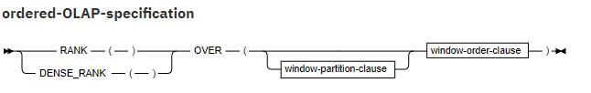
Online analytical processing (OLAP) specifications provide the ability to return ranking, row numbering, and aggregation information as a scalar value in the result of a query.
An OLAP specification can be included in an expression, in a select-list, or in the ORDER BY clause of a select-statement. The query result to which the OLAP specifications is applied is the result table of the innermost subselect that includes the OLAP specification.
An OLAP specification is not valid in a WHERE, VALUES, GROUP BY, HAVING, or SET clause. An OLAP specification cannot be used as an argument of an aggregate function.
https://www.ibm.com/support/knowledgecenter/SSEPEK_11.0.0/sqlref/src/tpc/db2z_olapspecification.html

Slide 22
rank()/dense_rank()
Specifies that the ordinal rank of a row within the specified window is computed. Rows that are not distinct with respect to the ordering within the specified window are assigned the same rank. The results of the ranking can be defined with or without gaps in the numbers that result from duplicate values.
row_number()
Specifies that a sequential row number is computed for the row that is defined by the ordering, starting with 1 for the first row. If the ORDER BY clause is not specified in the window, the row numbers are assigned to the rows in an arbitrary order, as the rows are returned.
SELECT EMPNO, LASTNAME, FIRSTNME, SALARY+BONUS AS TOTAL_SALARY,
RANK() OVER(ORDER BY SALARY+BONUS DESC) AS RANK_SALARY
FROM EMP WHERE SALARY+BONUS > 30000
ORDER BY LASTNAME;

Slide 23
LAG and LEAD functions
lag(row, offsect, default)
Provides access to more than one row of a table at the same time without a self-join. The lag function provides access to a row at a physical offset before that position.
lead(row, offsect, default)
Provides access to more than one row of a table at the same time without a self-join. The lead function provides access to a row at a given physical offset beyond that position.
If you do not specify the offset, the default is 1. The system returns the value in the optional default column, if the offset is beyond the scope of the window. If you do not specify the default, the value is null.
SELECT workdept, salary, LAG(salary)
OVER (ORDER BY salary),
LEAD(salary, 1, 0)
OVER (ORDER BY salary)
FROM employee
order by 1;

